Slide 1
Effect of Rivaroxaban on Thromboembolic Events in Patients with Heart Failure, Sinus Rhythm, and Coronary Disease
Embargoed until 10:45 a.m. CT/11:45 a.m. ET Sunday, Nov. 11, 2018
Barry Greenberg M.D.
University of California, San Diego
La Jolla, CA

Slide 2
Oversight Committees of COMMANDER HF
Steering Committee Members
Faiez Zannad, Barry Greenberg, Co-Chairs
Stefan D. Anker, William M. Byra, John G.F. Cleland, Mihai Gheorghiade (deceased), Carolyn S.P. Lam, Mandeep R. Mehra, James Neaton, Dirk J. van Veldhuisen
Independent Data Monitoring Committee Members
W. Douglas Weaver, Henry J. Dargie, Marc Klapholz, Bertram Pitt, Stuart J. Pocock, Yoshihiko Seino
The study was supported by Janssen.
We thank all the patients, investigators and site staff for participating in this trial.

Slide 3
Background for COMMANDER HF
Rates of readmission and death following an episode of worsening chronic heart failure (HF) remain high.^{1,2}
Therapies targeting a variety of mechanisms have thus far failed to improve outcomes following HF hospitalization.
Activation of thrombin-related pathways may contribute to HF disease progression by inducing inflammation, endothelial dysfunction, and arterial and venous thrombosis.³
However, prospective studies using warfarin in HF patients with reduced EF failed to demonstrate overall benefit.⁵⁻⁷
Maggioni AP, et al. Eur J Heart Fail. 2013.
Solomon SD, et al. Circulation. 2007.
Borissoff JI, et al. Cardiovas Res. 2009.
Cokkinos DV, et al. Eur J Heart Fail. 2006
5. Massie BM, et al. Circulation. 2009
6. Cleland JG, et al. Am Heart J. 2004
7. Homma S, et al. N Engl J Med. 2012

Slide 4
Background for COMMANDER HF (cont.)
Unlike warfarin, rivaroxaban directly targets thrombin generation.
Rivaroxaban (2.5 mg twice daily), in addition to antiplatelet agents reduced CV death, MI, and stroke in two trials:
- ATLAS ACS 2 TIMI 51 (post-MI and unstable angina)¹
- COMPASS (stable CAD or PVD)²
Both of these trials included patients with HF^{3,4}.
1. Mega JL, et al. N Engl J Med. 2012
2. Eikelboom JW, et al. N Engl J Med. 2017
3. Korjian et al Am J Cardiol. 2018 Sep 7. Published online ahead of print
4. Branch K et al. ESC HFA, Vienna

Slide 5
Rivaroxaban Reduces Morbidity and Mortality in Patients with Recent ACS who Had HF at Presentation¹ From ATLAS ACS 2 TIMI 51
P=0.001
P=0.002
P=0.001
Major bleeding, according to TIMI criteria, occurred in slightly fewer patients receiving rivaroxaban 2.5mg bid than placebo (0.4% vs. 0.7%)
1. Korjian S et al Am J Cardiol. 2018 Sep 7. Published online ahead of print

Slide 6
COMMANDER HF
COMMANDER HF tested the hypothesis that, compared with placebo, rivaroxaban 2.5 mg twice daily added to background anti-platelet therapy, would reduce rates of death and CV events in patients with recent worsening of chronic HF, reduced EF, CAD, and sinus rhythm.
The primary efficacy outcome was a composite of all-cause mortality, MI, or stroke.
The main secondary outcome was a composite of CV death and HF hospitalization.

Slide 7
Study Design
Screening Period
Double Blind
Treatment Phase
Follow-Up After GTED
Rivaroxaban 2.5 mg bid + standard of care therapy
30±15 days
End of Study Visit
≤21 days of Index Event
R
N=5000
q 12 weeks
Patients with HFrEF and CAD are appropriate regardless of whether they are managed via the traditional inpatient hospital pathway or via the outpatient HF clinic pathway
Placebo bid + standard of care therapy
At Hospital Discharge & up to 30 Days Post Discharge
Visits:
Day 1 = R
Week 4
Week 12
q 3 months
Early Permanent Study Drug Discontinuation
Continue Follow-Up
Global Treatment End Date
(GTED)
Zannad F, et al. Eur J Heart Fail. 2015:17(7):735-742.

Slide 8
Rivaroxaban Failed to Improve Outcomes in COMMANDER HF
Primary Efficacy Outcome
Secondary Efficacy Outcome
HR (95% CI) 0.94 (0.84, 1.05)
HR (95% CI)
1.01 (0.92, 1.10)
All cause mortality, MI and stroke
CV mortality and HF hospitalization
Zannad F et al. NEJM, 2018

Slide 9
Primary Efficacy Outcome & Components COMMANDER HF (ITT*)
 | Rivaroxaban |  | Placebo |  | Rivaroxaban vs. Placebo
 |  | Event Rate |  | Event Rate |  | Log-rank
Outcomes | n (%) | / (100 pt-yr) | n (%) | / (100 pt-yr) | HR (95% CI) | P-value
 | N=2507 |  | N=2515
Primary efficacy (composite) | 626 (25.0) | 13.44 | 658 (26.2) | 14.27 | 0.94 (0.84, 1.05) | 0.27
All-cause mortality | 546 (21.8) | 11.41 | 556 (22.1) | 11.63 | 0.98 (0.87, 1.10) | -
MI | 98 ( 3.9) | 2.08 | 118 ( 4.7) | 2.52 | 0.83 (0.63, 1.08) | -
Stroke | 51 ( 2.0) | 1.08 | 76 ( 3.0) | 1.62 | 0.66 (0.47, 0.95) | -
Primary outcome composite driven by mortality, a large proportion of which
was due to worsening HF
* ITT, Intent to Treat
Notes:
TEFPRI001: Efficacy Analysis of Time to First Occurrence of Primary Efficacy Outcome (All-Cause Mortality, MI or Stroke) - Up-to-GTED (Study 39039039HFA3001: Intent-To-Treat Analysis Set)
Note: Intent-to-Treat Analysis Set includes all randomized unique subjects who have a signed valid informed consent.
Note: Up-to-GTED is the observation period from randomization to the GTED inclusively.
Note: n = number of subjects with events; N = number of subjects at risk; % = 100 * n / N; Event Rate / (100 pt-yr) = 100*n/(total risk exposure).
Note: p-values (two-sided) are from the log-rank test stratified by region.
Note: HR (95% CI): Hazard ratios (95% confidence interval) are from a Cox proportional hazards model stratified by region with treatment assignment as the only effect.
Abbreviations: GTED = Global Treatment End Date (the date when approximately 1,200 primary efficacy outcome events are predicted to have occurred (date is based on site local time)); MI = Myocardial Infarction.

Slide 10
Primary Efficacy Outcome & Components COMMANDER HF (ITT*)
 | Rivaroxaban |  | Placebo |  | Rivaroxaban vs. Placebo
 |  | Event Rate |  | Event Rate |  | Log-rank
Outcomes | n (%) | / (100 pt-yr) | n (%) | / (100 pt-yr) | HR (95% CI) | P-value
 | N=2507 |  | N=2515
Primary efficacy (composite) | 626 (25.0) | 13.44 | 658 (26.2) | 14.27 | 0.94 (0.84, 1.05) | 0.27
All-cause mortality | 546 (21.8) | 11.41 | 556 (22.1) | 11.63 | 0.98 (0.87, 1.10) | -
MI | 98 ( 3.9) | 2.08 | 118 ( 4.7) | 2.52 | 0.83 (0.63, 1.08) | -
Stroke | 51 ( 2.0) | 1.08 | 76 ( 3.0) | 1.62 | 0.66 (0.47, 0.95) | -
Primary outcome composite driven by mortality, a large proportion of which
were due to worsening HF
Testing for homogeneity between the 3 components of the
primary outcome suggested HRs vary (p=0.06) and there were
numerical advantages of rivaroxaban compared to placebo
for MI and stroke, both of which are classical thromboembolic events.
* ITT, Intent to Treat
Notes:
TEFPRI001: Efficacy Analysis of Time to First Occurrence of Primary Efficacy Outcome (All-Cause Mortality, MI or Stroke) - Up-to-GTED (Study 39039039HFA3001: Intent-To-Treat Analysis Set)
Note: Intent-to-Treat Analysis Set includes all randomized unique subjects who have a signed valid informed consent.
Note: Up-to-GTED is the observation period from randomization to the GTED inclusively.
Note: n = number of subjects with events; N = number of subjects at risk; % = 100 * n / N; Event Rate / (100 pt-yr) = 100*n/(total risk exposure).
Note: p-values (two-sided) are from the log-rank test stratified by region.
Note: HR (95% CI): Hazard ratios (95% confidence interval) are from a Cox proportional hazards model stratified by region with treatment assignment as the only effect.
Abbreviations: GTED = Global Treatment End Date (the date when approximately 1,200 primary efficacy outcome events are predicted to have occurred (date is based on site local time)); MI = Myocardial Infarction.

Slide 11
Rationale for Analysis of Thromboembolic Events
These findings suggest that in the high risk HF population enrolled in COMMANDER HF:
-the primary composite was driven by events that were not
influenced by rivaroxaban 2.5 mg twice daily.
-an effect of rivaroxaban on thromboembolic events might have
been masked by the preponderance of events related to
worsening heart failure.
We postulated that low dose rivaroxaban would be superior to placebo in reducing the risk of thromboembolic events in patients enrolled in COMMANDER HF.

Slide 12
Composite Thromboembolic Event End-point
The composite endpoint for this post-hoc analysis included:
- MI
- ischemic stroke
- sudden/unwitnessed death
- pulmonary embolism or symptomatic deep venous thrombosis
All events included in this composite had been pre-defined in the study protocol and were required to fulfill specific criteria which were verified by the sponsor site team.

Slide 13
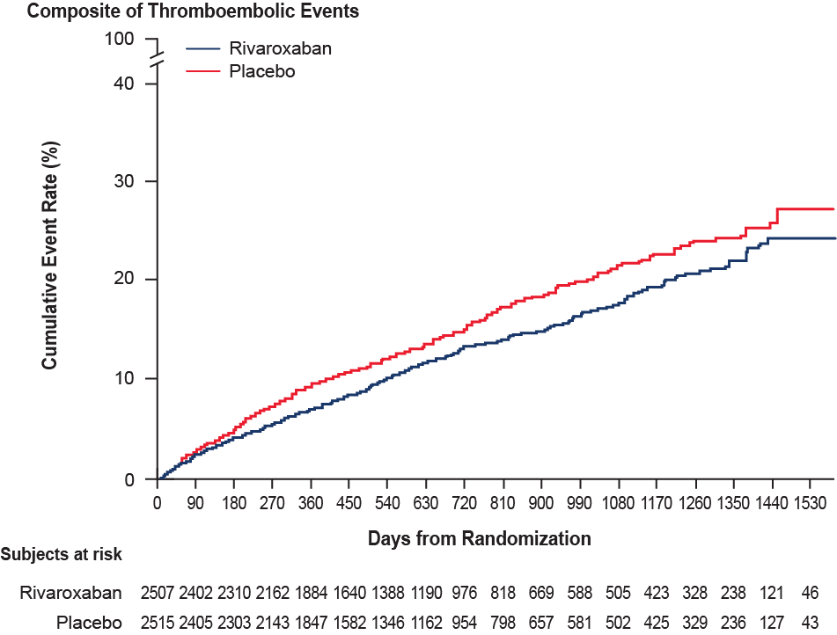
KM Estimates for the Post Hoc Thromboembolic Event Composite
HR (95% CI)
0.83 (0.72, 0.96)
p=0.013
Overall, 14.3% of patients experienced a thromboembolic event over a median
follow-up of 19.6 months with the event rate of 7.0 and 8.5 per 100 patient years
in the rivaroxaban and placebo groups, respectively.

Slide 14
Results of the Thromboembolic Event Analysis*
 | Rivaroxaban (N=2507) |  | Placebo (N=2515) |  | Rivaroxaban vs. Placebo
Outcomes | n (%) | Event Rate/ 100 Patient-yr | n (%) | Event Rate/ 100 Patient-yr | Hazard Ratio (95% CI) | P Value
Composite of Thromboembolic Events | 328 (13.1) | 7.0 | 390 (15.5) | 8.5 | 0.83 (0.72,0.96) | 0.013
MI | 98 (3.9) | 2.1 | 118 (4.7) | 2.5 | 0.83 (0.63,1.08)
Ischemic Stroke | 41 (1.6) | 0.9 | 63 (2.5) | 1.3 | 0.64 (0.43,0.95)
Sudden/Unwitnessed Death | 190 (7.6) | 4.0 | 215 (8.5) | 4.5 | 0.88 (0.73,1.07)
Symptomatic PE | 11 (0.4) | 0.2 | 9 (0.4) | 0.2 | 1.24 (0.51,2.99)
Symptomatic DVT | 5 (0.2) | 0.1 | 7 (0.3) | 0.1 | 0.71 (0.23,2.24)
*Time to First Occurrence of an Outcome Event

Slide 15
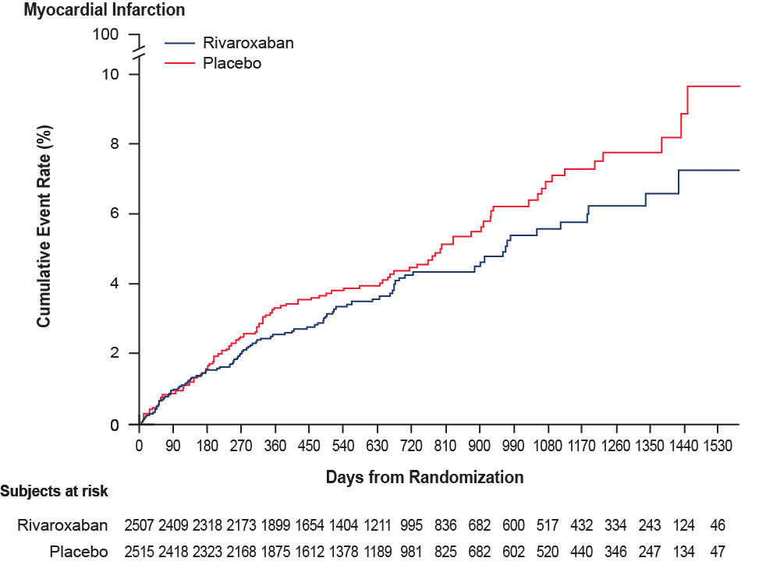
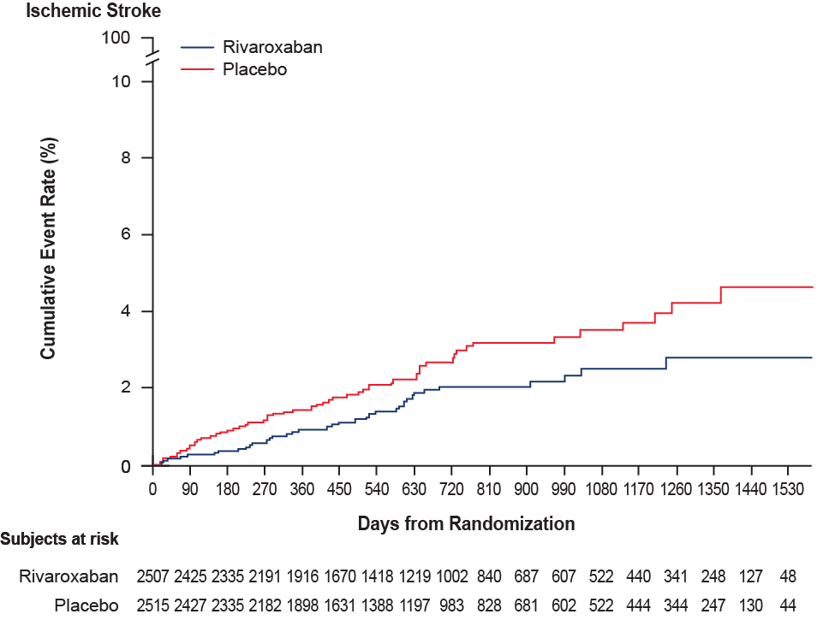
KM Estimates for MI and Stroke
HR (95% CI)
0.83 (0.63, 1.08)
HR (95% CI)
0.64 (0.43, 0.95)

Slide 16
Comparing HF Patient Outcomes Between Rivaroxaban Trials
COMMANDER HF¹
Post HF hospitalization
ATLAS (HF Subgroup)² History of CHF at Randomization
COMPASS³
Chronic Stable HF subgroup
Incidence rate
ITT up to GTED
mITT
ITT
* 34.8% of patients received DAPT at baseline, while 93.1% received ASA alone at baseline
* 86.7% of patients received DAPT at baseline, while 13.3% received ASA alone at baseline
COMMANDER HF enrolled high risk HF patients after recent worsening and HF deaths, rather than deaths mediated by atherothrombotic events, likely contributed to a substantial proportion of all deaths.
¹ Zannad F et al., N Engl J Med 2018; ² Korjian S et al Am J Cardiol. 2018 Sep 7. Published online ahead of print; ³ Branch KR. COMPASS: low-dose rivaroxaban plus aspirin may benefit patients with chronic CAD, PAD, HF. Presented at Late-breaking Trial IV: Registries, Heart Failure 2018 and World Congress on Acute Heart Failure, Vienna, May 26-29, 2018

Slide 17
Limitations
Although all of the components of the thrombotic composite had been pre-defined, this was a post hoc analysis.
Endpoints were not adjudicated by an independent events committee.
COMMANDER HF enrolled patients with reduced EF and the effect of rivaroxaban on thromboembolic events in a HFpEF population is unknown.

Slide 18
Summary
Thromboembolic events, while not the major source of morbidity and mortality in COMMANDER HF, occurred commonly during follow-up.
In this post-hoc analysis, rivaroxaban reduced risk of thromboembolic events compared to placebo.

Slide 19
Conclusion
The findings of this post hoc analysis support the possibility that low-dose rivaroxaban may reduce the risk of thromboembolic events in HF patients.
However, confirmation of these results by a prospective trial is required in order to establish a role for low dose rivaroxaban in treating HF patients.

Slide 20
Back up Slides

Slide 21
Principal Safety Outcome (Safety, On-Treatment)
 | Rivaroxaban |  | Placebo |  | Rivaroxaban vs. Placebo | P value
 | N=2499 |  | N=2509
Principal safety (composite) | 18 ( 0.7) | 0.44 | 23 ( 0.9) | 0.55 | 0.80 ( 0.43, 1.49) | 0.484
Fatal bleeding | 9 ( 0.4) | 0.22 | 9 ( 0.4) | 0.22 | 1.03 ( 0.41, 2.59) | 0.951
Bleeding in critical space with potential for permanent disability | 13 ( 0.5) | 0.32 | 20 ( 0.8) | 0.48 | 0.67 ( 0.33, 1.34) | 0.253
ISTH major bleeding | 82 ( 3.3) | 2.04 | 50 ( 2.0) | 1.21 | 1.68 ( 1.18, 2.39) | 0.003
ISTH: HGB decreases ≥ 2g/dL | 55 ( 2.2) | 1.37 | 30 ( 1.2) | 0.73 | 1.87 ( 1.20, 2.91) | 0.005
ISTH: transfusions ≥ 2 Units | 31 ( 1.2) | 0.77 | 18 ( 0.7) | 0.43 | 1.74 ( 0.98, 3.12) | 0.058
ISTH: critical bleeding sites | 25 ( 1.0) | 0.62 | 23 ( 0.9) | 0.56 | 1.12 ( 0.63, 1.97) | 0.699
ISTH: fatal outcome | 3 ( 0.1) | 0.07 | 7 ( 0.3) | 0.17 | 0.45 ( 0.12, 1.72) | 0.228
Bleeding requiring hospitalization | 61 ( 2.4) | 1.52 | 48 ( 1.9) | 1.16 | 1.30 ( 0.89, 1.90) | 0.170
21
Notes:
TOTPR001: Analysis of Time to First Occurrence of Principal Safety Outcome (Fatal Bleeding or Bleeding into a Critical Space with
a Potential for Permanent Disability) - On-Treatment
(Study 39039039HFA3001: Safety Analysis Set)
Note: Safety Analysis Set includes all intent-to-treat subjects who received at least one dose of study drug.
Note: On-Treatment is the observation period from the first dose of the study drug to 2 days after the last dose of the study drug, inclusively.
Note: n = number of subjects with events; N = number of subjects at risk; % = 100 * n / N; Event Rate / (100 pt-yr) = 100*n/(total risk exposure).
(1) Includes all categories of fatal bleeding:
Category 1: Any ISTH major bleeding event considered to be the primary cause of death by the investigator
Category 2: Any ISTH major bleeding event not considered to be the primary cause of death by the investigator but results in death within 7 days
Category 3: Any bleeding event that results in a hospital stay and death within 7 days
Bleeding into a critical space with a potential for permanent disability includes these 7 critical
spaces (intracranial, intraspinal, intraocular [vitreous or retinal], pericardial, intra-articular, retroperitoneal, intramuscular with compartment syndrome)
where investigator has determined there was the potential for permanent disability.
Note: Each Safety subject may be counted in the Principal Safety Outcome row and may also be counted in one or both of the component endpoint rows.
Note: p-values (two-sided) are from the log-rank test stratified by region.
Note: HR (95% CI): Hazard ratios (95% confidence interval) are from a Cox proportional hazards model stratified by region with treatment assignment as the only effect.
totpr001.rtf generated by totpr001.sas, 29MAY2018 08:54

Slide 22
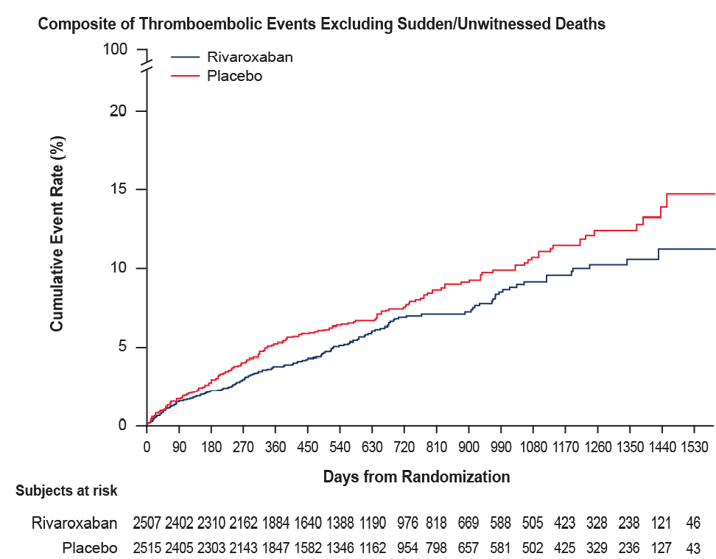
KM Estimates for the Thromboembolic Event Composite Excluding Sudden/Unwitnessed Deaths
HR (95% CI)
0.80 (0.64, 0.98)

Slide 23
COMMANDER-HF Patient Baseline Characteristics
Characteristic | Rivaroxaban (N=2507) | Placebo (N=2515) | Total (N=5022)
Age — yr | 66.51±10.07 | 66.28±10.27 | 66.40±10.17
Female sex — no. (%) | 551 (22.0) | 599 (23.8) | 1150 (22.9)
White Race — no. (%) | 2063 (82.3) | 2065 (82.1) | 4128 (82.2)
Medical history — no. (%)
Myocardial infarction | 1911 (76.2) | 1892 (75.2) | 3803 (75.7)
Stroke | 208 ( 8.3) | 245 ( 9.7) | 453 ( 9.0)
Hypertension | 1897 (75.7) | 1886 (75.0) | 3783 (75.3)
Diabetes | 1024 (40.8) | 1028 (40.9) | 2052 (40.9)
Clinical features of heart failure
BNP (pg/mL) | 702.0 | 695.5 | 696
NT-proBNP(pg/mL) | 2840.0 | 2900.0 | 2849.5
D-dimer (ug/L) | 360 | 360 | 360
Median Ejection fraction (IQR) (%) | 35 (28-38) | 34 (27-38) | 34 (28-38)
New York Heart Association classification — no. (%)
I | 80 ( 3.2) | 69 ( 2.7) | 149 ( 3.0)
II | 1122 (44.8) | 1096 (43.6) | 2218 (44.2)
III | 1208 (48.2) | 1254 (49.9) | 2462 (49.0)
IV | 96 ( 3.8) | 96 ( 3.8) | 192 ( 3.8)
Therapies at baseline — no. (%)
Aspirin | 2329 (92.9) | 2346 (93.3) | 4675 (93.1)
Thienopyridine | 1043 (41.6) | 972 (38.6) | 2015 (40.1)
Dual antiplatelet therapy | 907 (36.2) | 839 (33.4) | 1746 (34.8)
Cardiac devices | 345 (13.8) | 316 (12.6) | 661 (13.2)

Slide 24
Time to First Occurrence of an Outcome Event
 | Rivaroxaban (N=2507) |  | Placebo (N=2515) |  | Rivaroxaban vs. Placebo
Outcomes | n (%) | Event Rate/ 100 Patient-yr | n (%) | Event Rate/ 100 Patient-yr | Hazard Ratio (95% CI) | P Value
COMMANDER HF Primary Endpoint (Composite of ACM/MI/Stroke) | 626 (25.0) | 13.4 | 658 (26.2) | 14.3 | 0.94 (0.84, 1.05) | 0.27
ACM | 546 (21.8) | 11.4 | 556 (22.1) | 11.6 | 0.98 (0.87,1.10)
MI | 98 (3.9) | 2.1 | 118 (4.7) | 2.5 | 0.83 (0.63,1.08)
Stroke | 51 (2.0) | 1.1 | 76 (3.0) | 1.6 | 0.66 (0.47, 0.95)
Composite of Thromboembolic Events | 328 (13.1) | 7.0 | 390 (15.5) | 8.5 | 0.83 (0.72,0.96) | 0.013
MI | 98 (3.9) | 2.1 | 118 (4.7) | 2.5 | 0.83 (0.63,1.08)
Ischemic Stroke | 41 (1.6) | 0.9 | 63 (2.5) | 1.3 | 0.64 (0.43,0.95)
Sudden/Unwitnessed Death | 190 (7.6) | 4.0 | 215 (8.5) | 4.5 | 0.88 (0.73,1.07)
Symptomatic PE | 11 (0.4) | 0.2 | 9 (0.4) | 0.2 | 1.24 (0.51,2.99)
Symptomatic DVT | 5 (0.2) | 0.1 | 7 (0.3) | 0.1 | 0.71 (0.23,2.24)
Composite of Non-Thromboembolic Events | 363 (14.5) | 7.6 | 346 (13.8) | 7.2 | 1.05 (0.91,1.22) | 0.51
Death Other Than CV Death | 93 (3.7) | 1.9 | 80 (3.2) | 1.7 | 1.16 (0.86,1.57)
CV Death Other Than Sudden/ Unwitnessed Death | 263 (10.5) | 5.5 | 261 (10.4) | 5.5 | 1.01 (0.85,1.19)
Non-Ischemic Stroke | 11 (0.4) | 0.2 | 13 (0.5) | 0.3 | 0.85 (0.38,1.90)
Composite of CV Death, MI or Stroke | 537 (21.4) | 11.5 | 584 (23.2) | 12.7 | 0.91 (0.81,1.02) | 0.11
CV Death | 453 (18.1) | 9.5 | 476 (18.9) | 10.0 | 0.95 (0.84,1.08)
MI | 98 (3.9) | 2.1 | 118 (4.7) | 2.5 | 0.83 (0.63,1.08)
Stroke | 51 (2.0) | 1.1 | 76 (3.0) | 1.6 | 0.66 (0.47,0.95)

